Slide 1
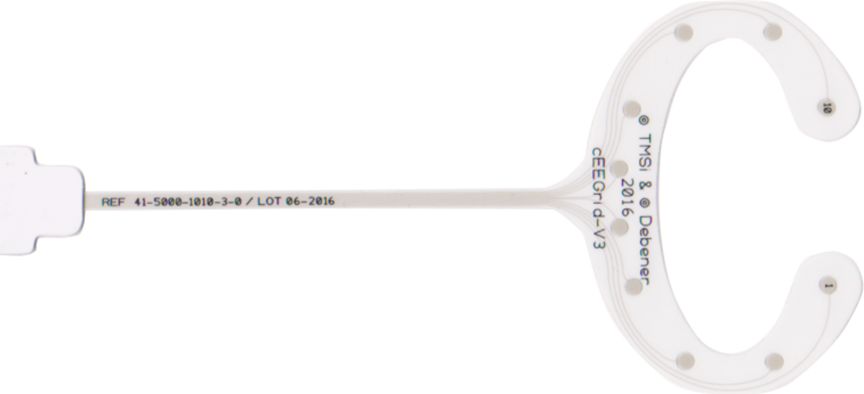
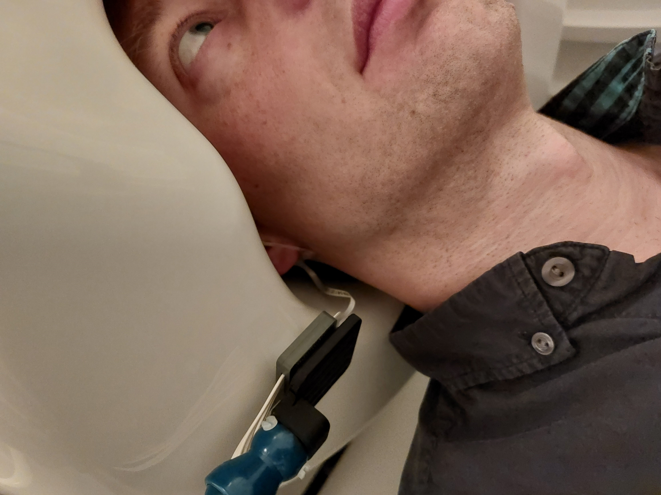
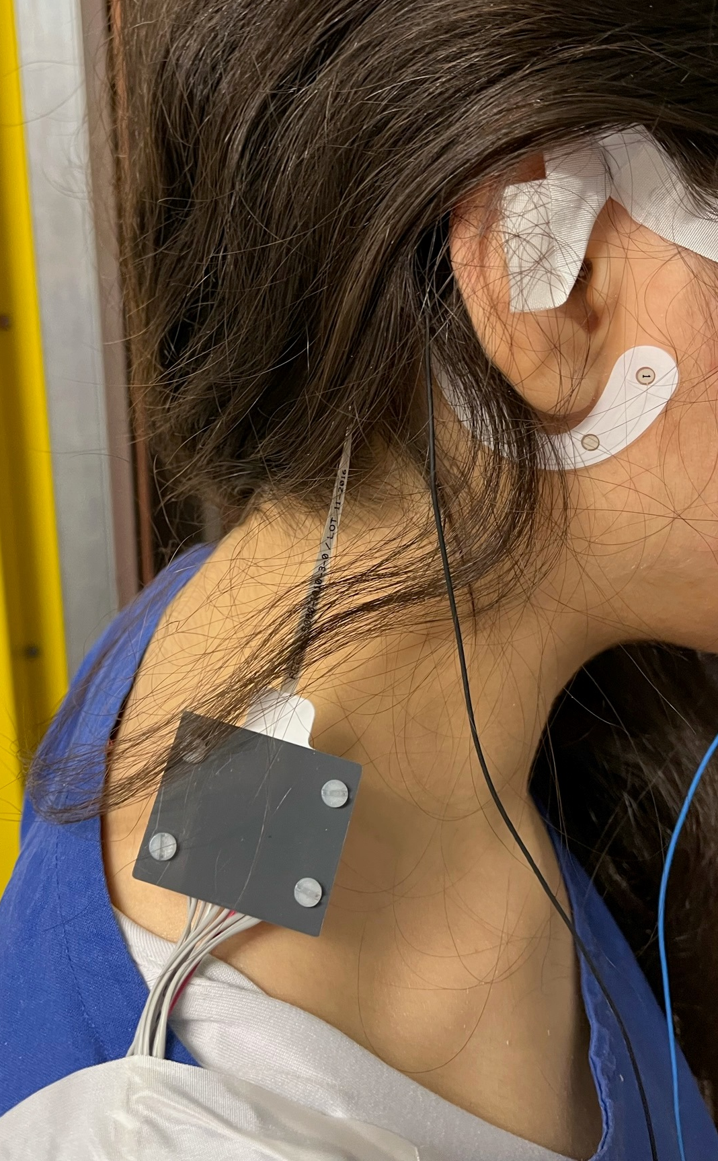
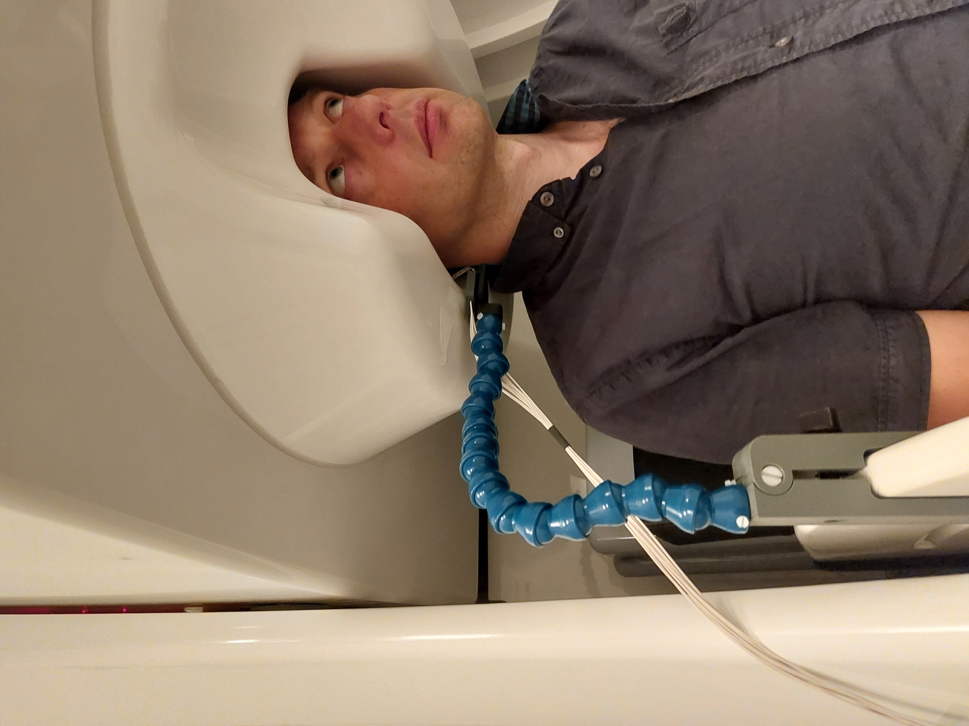
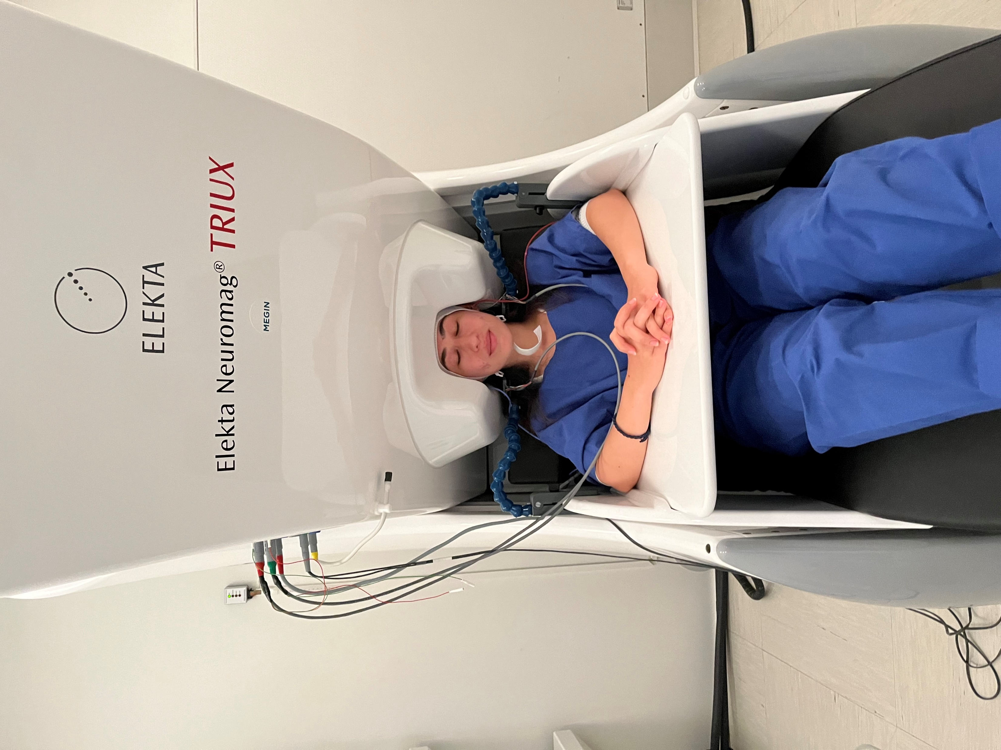

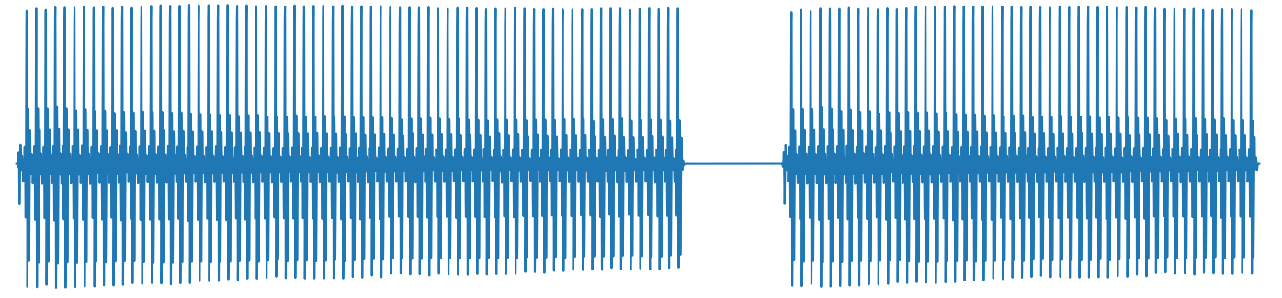
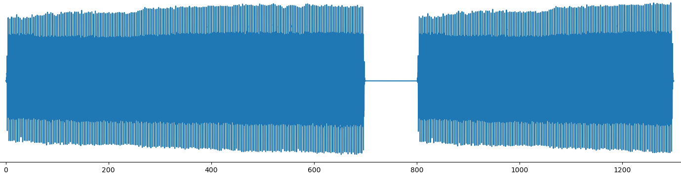
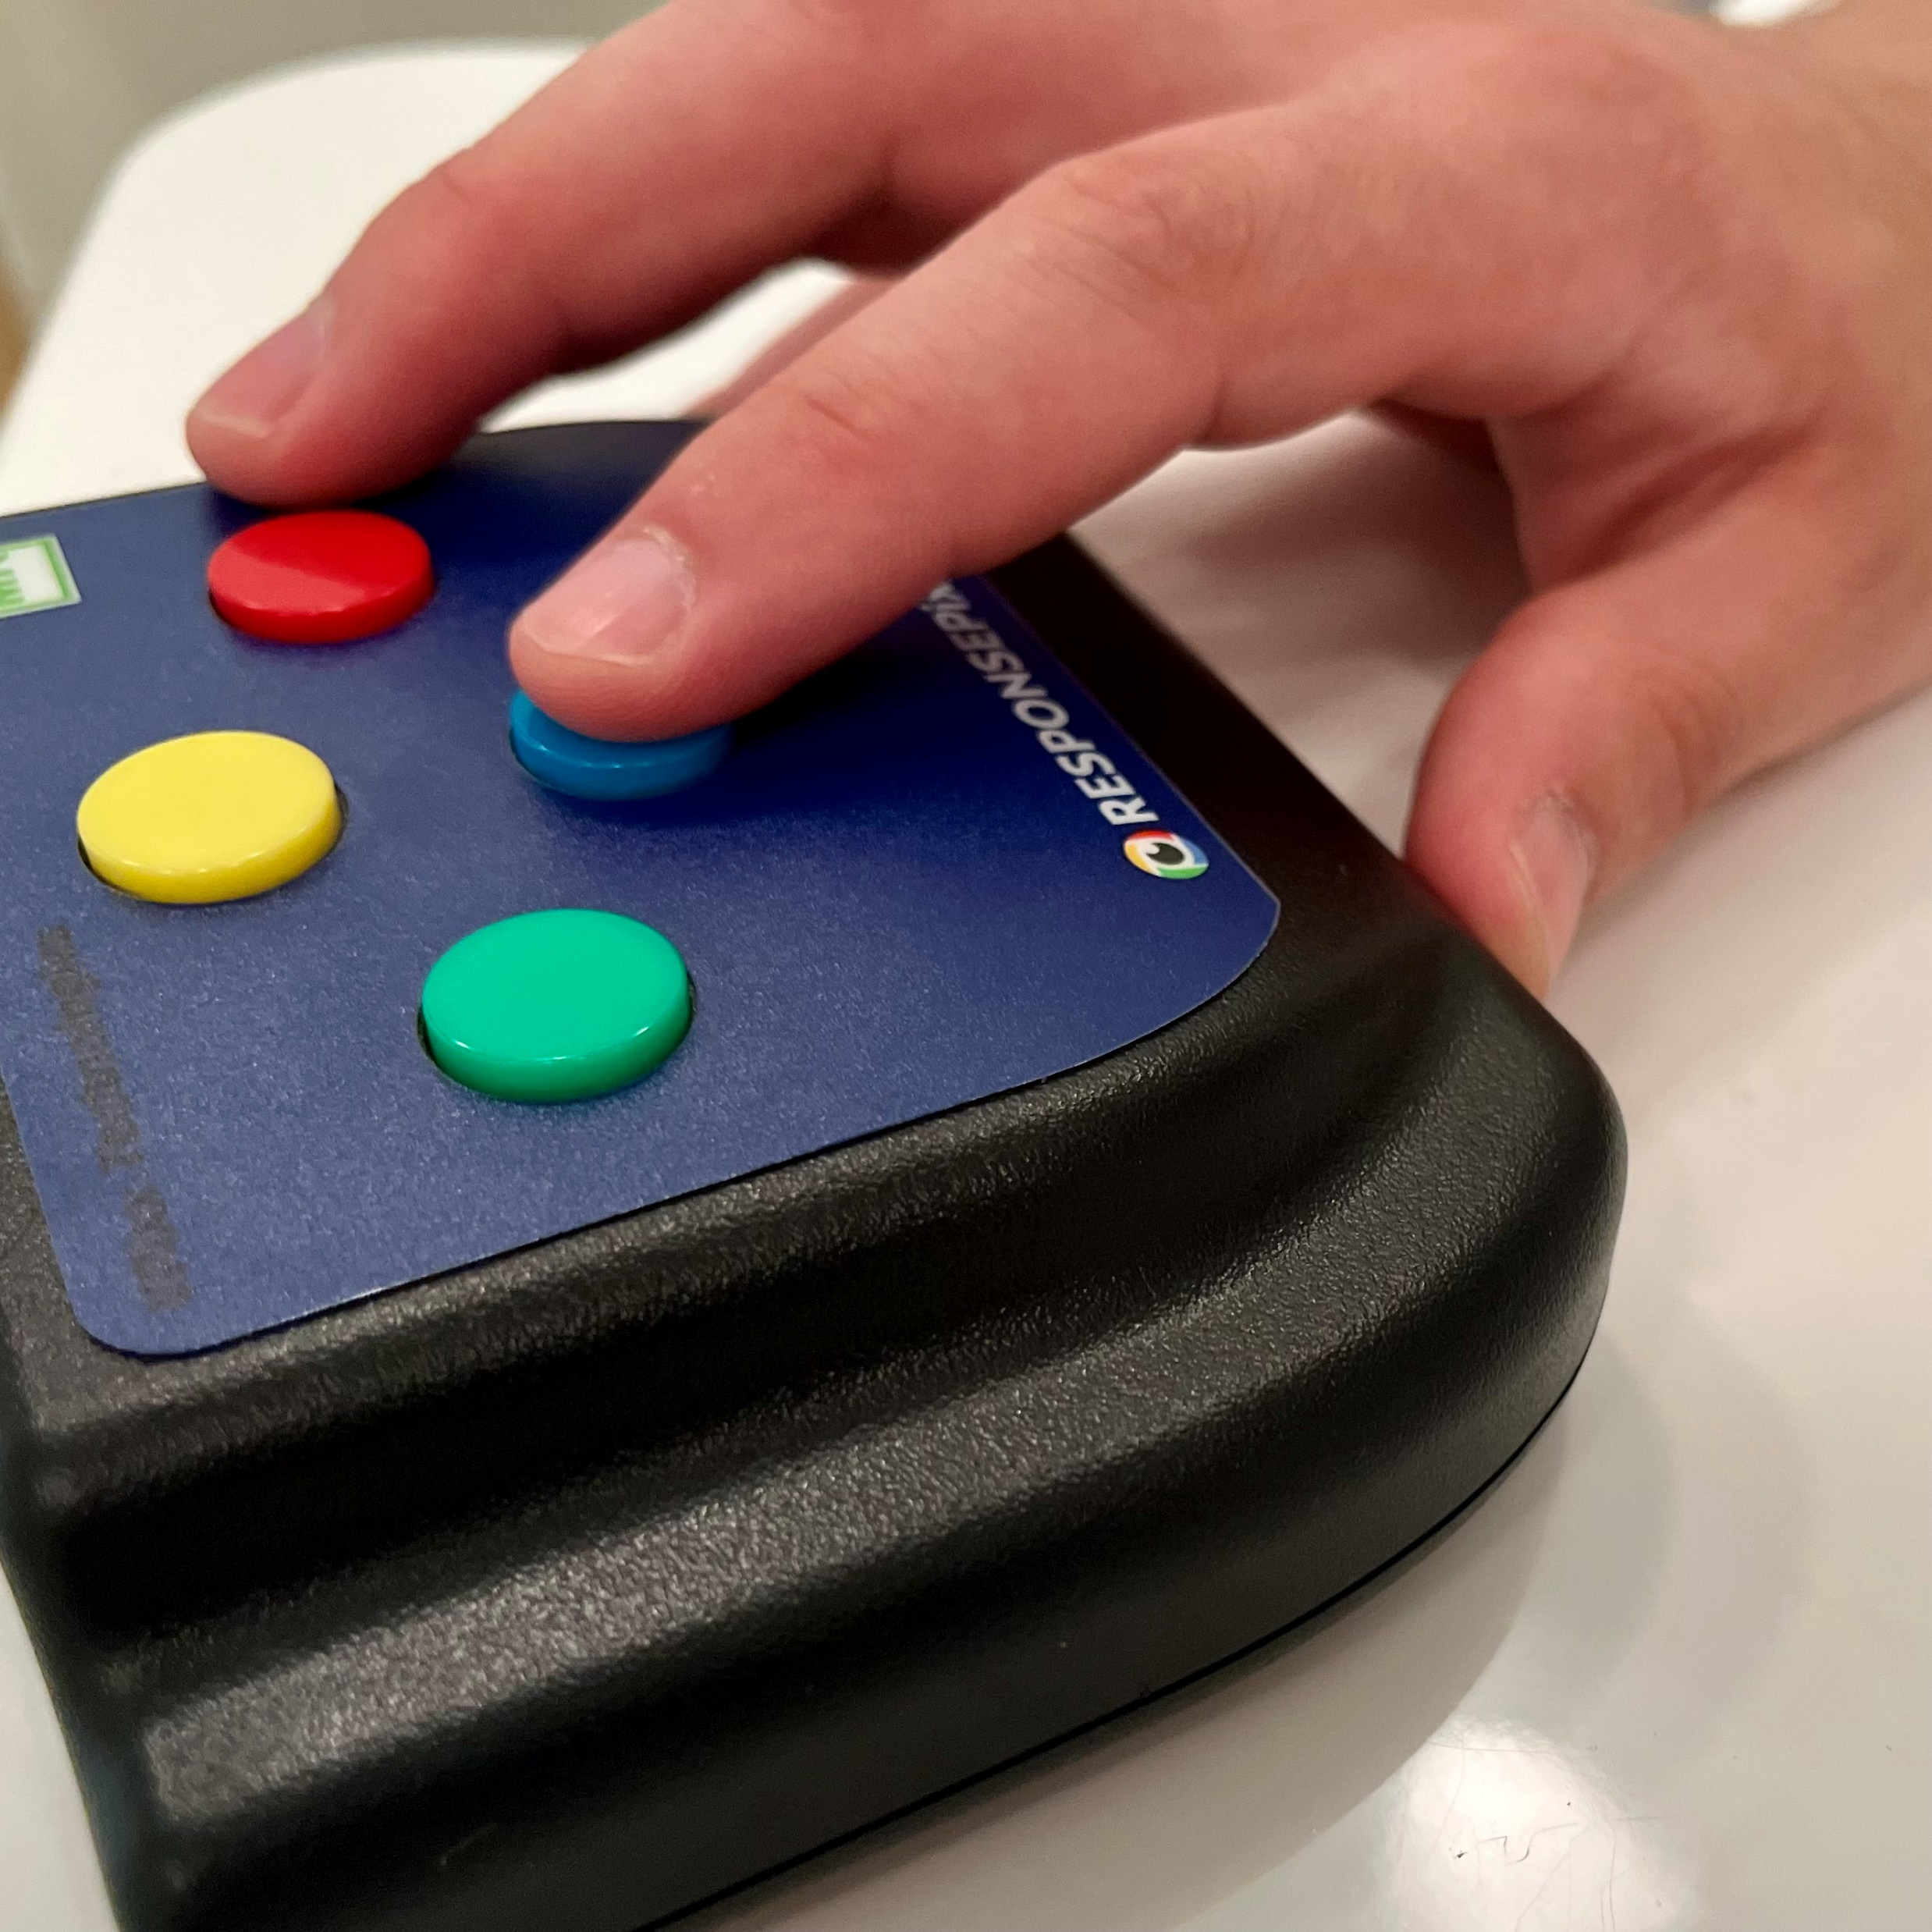
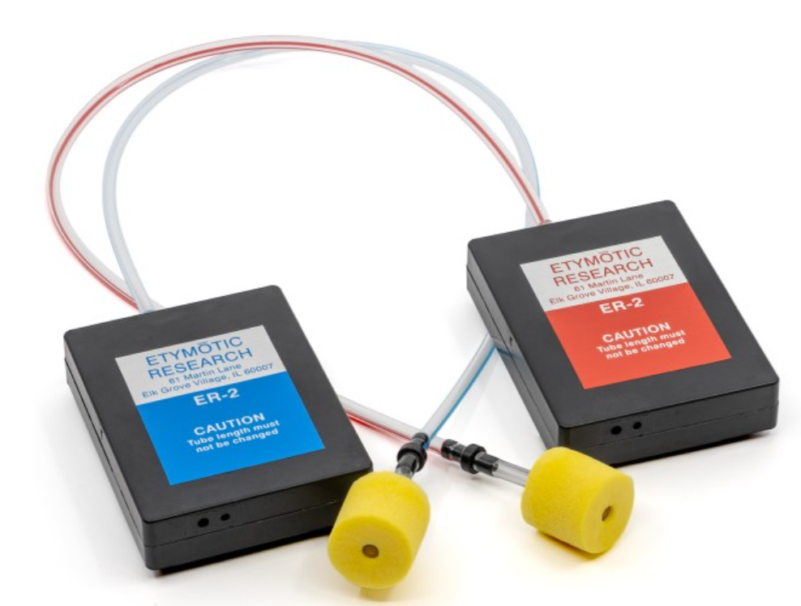
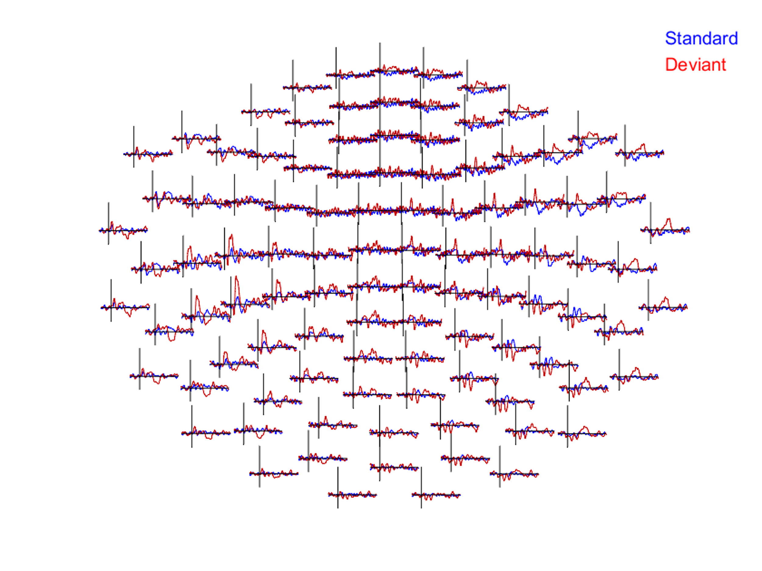
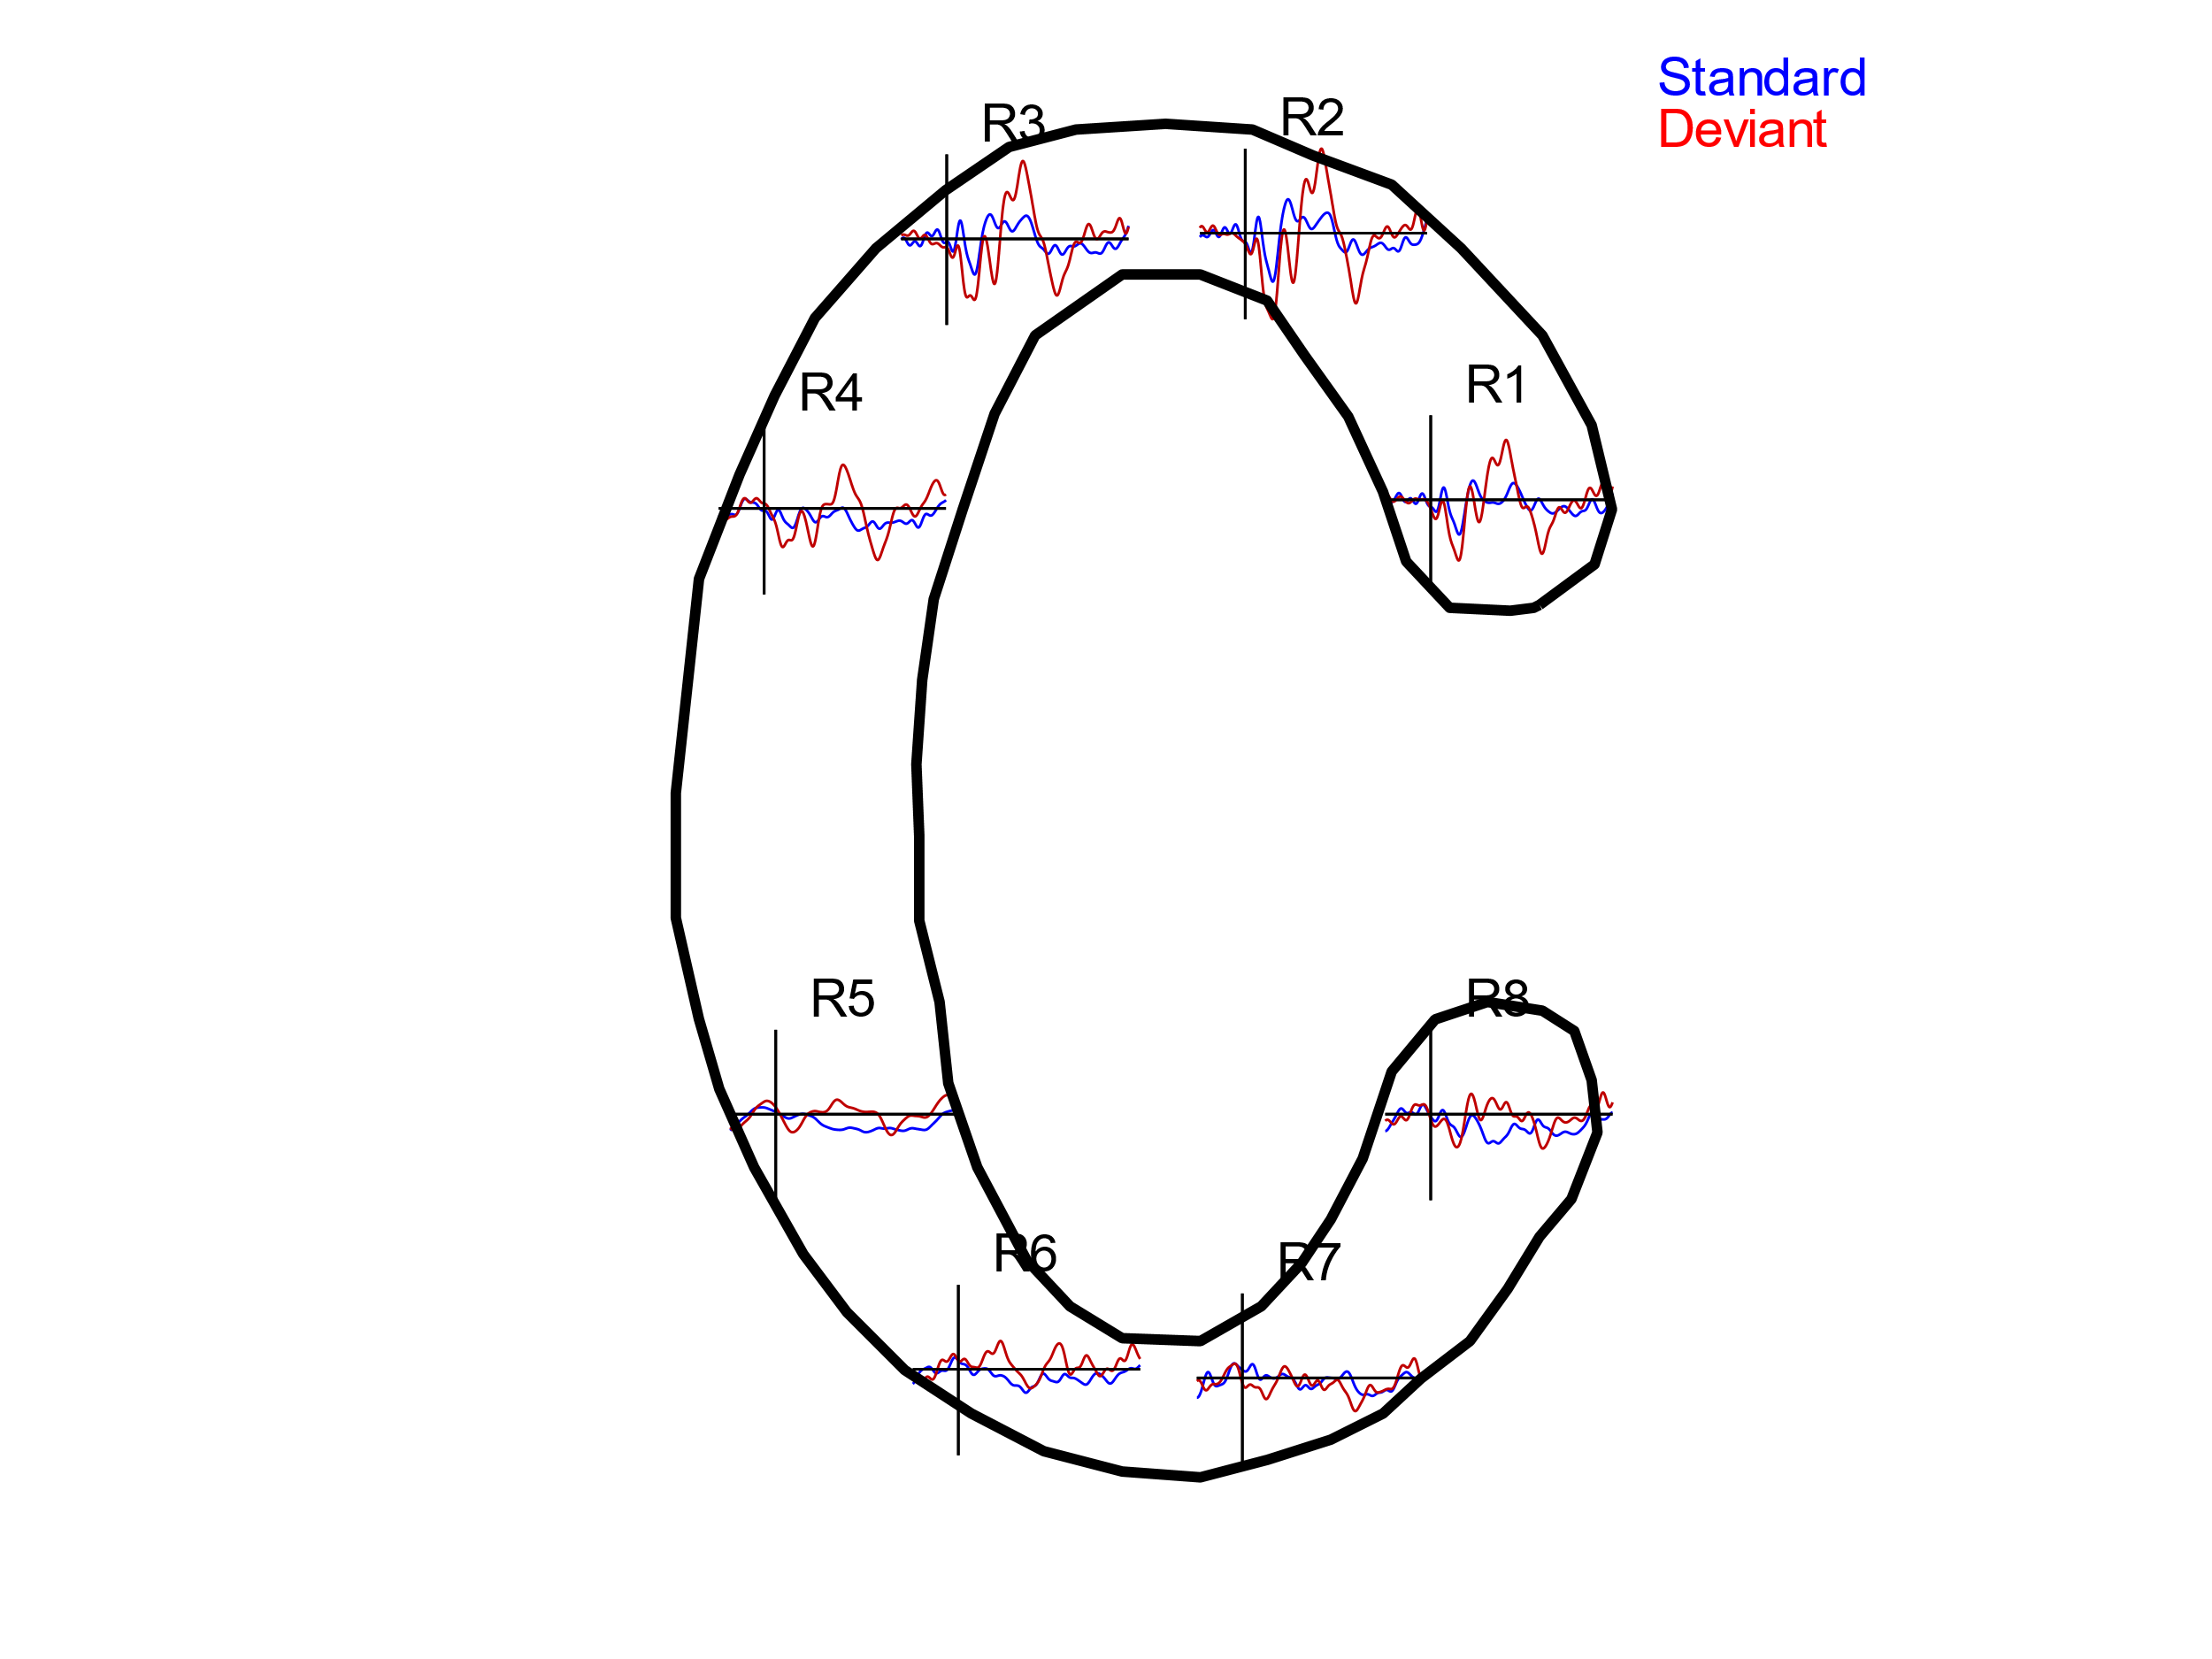
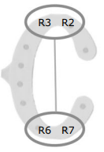
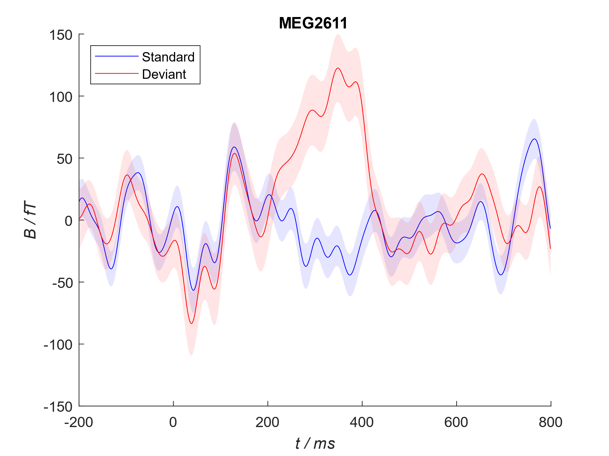
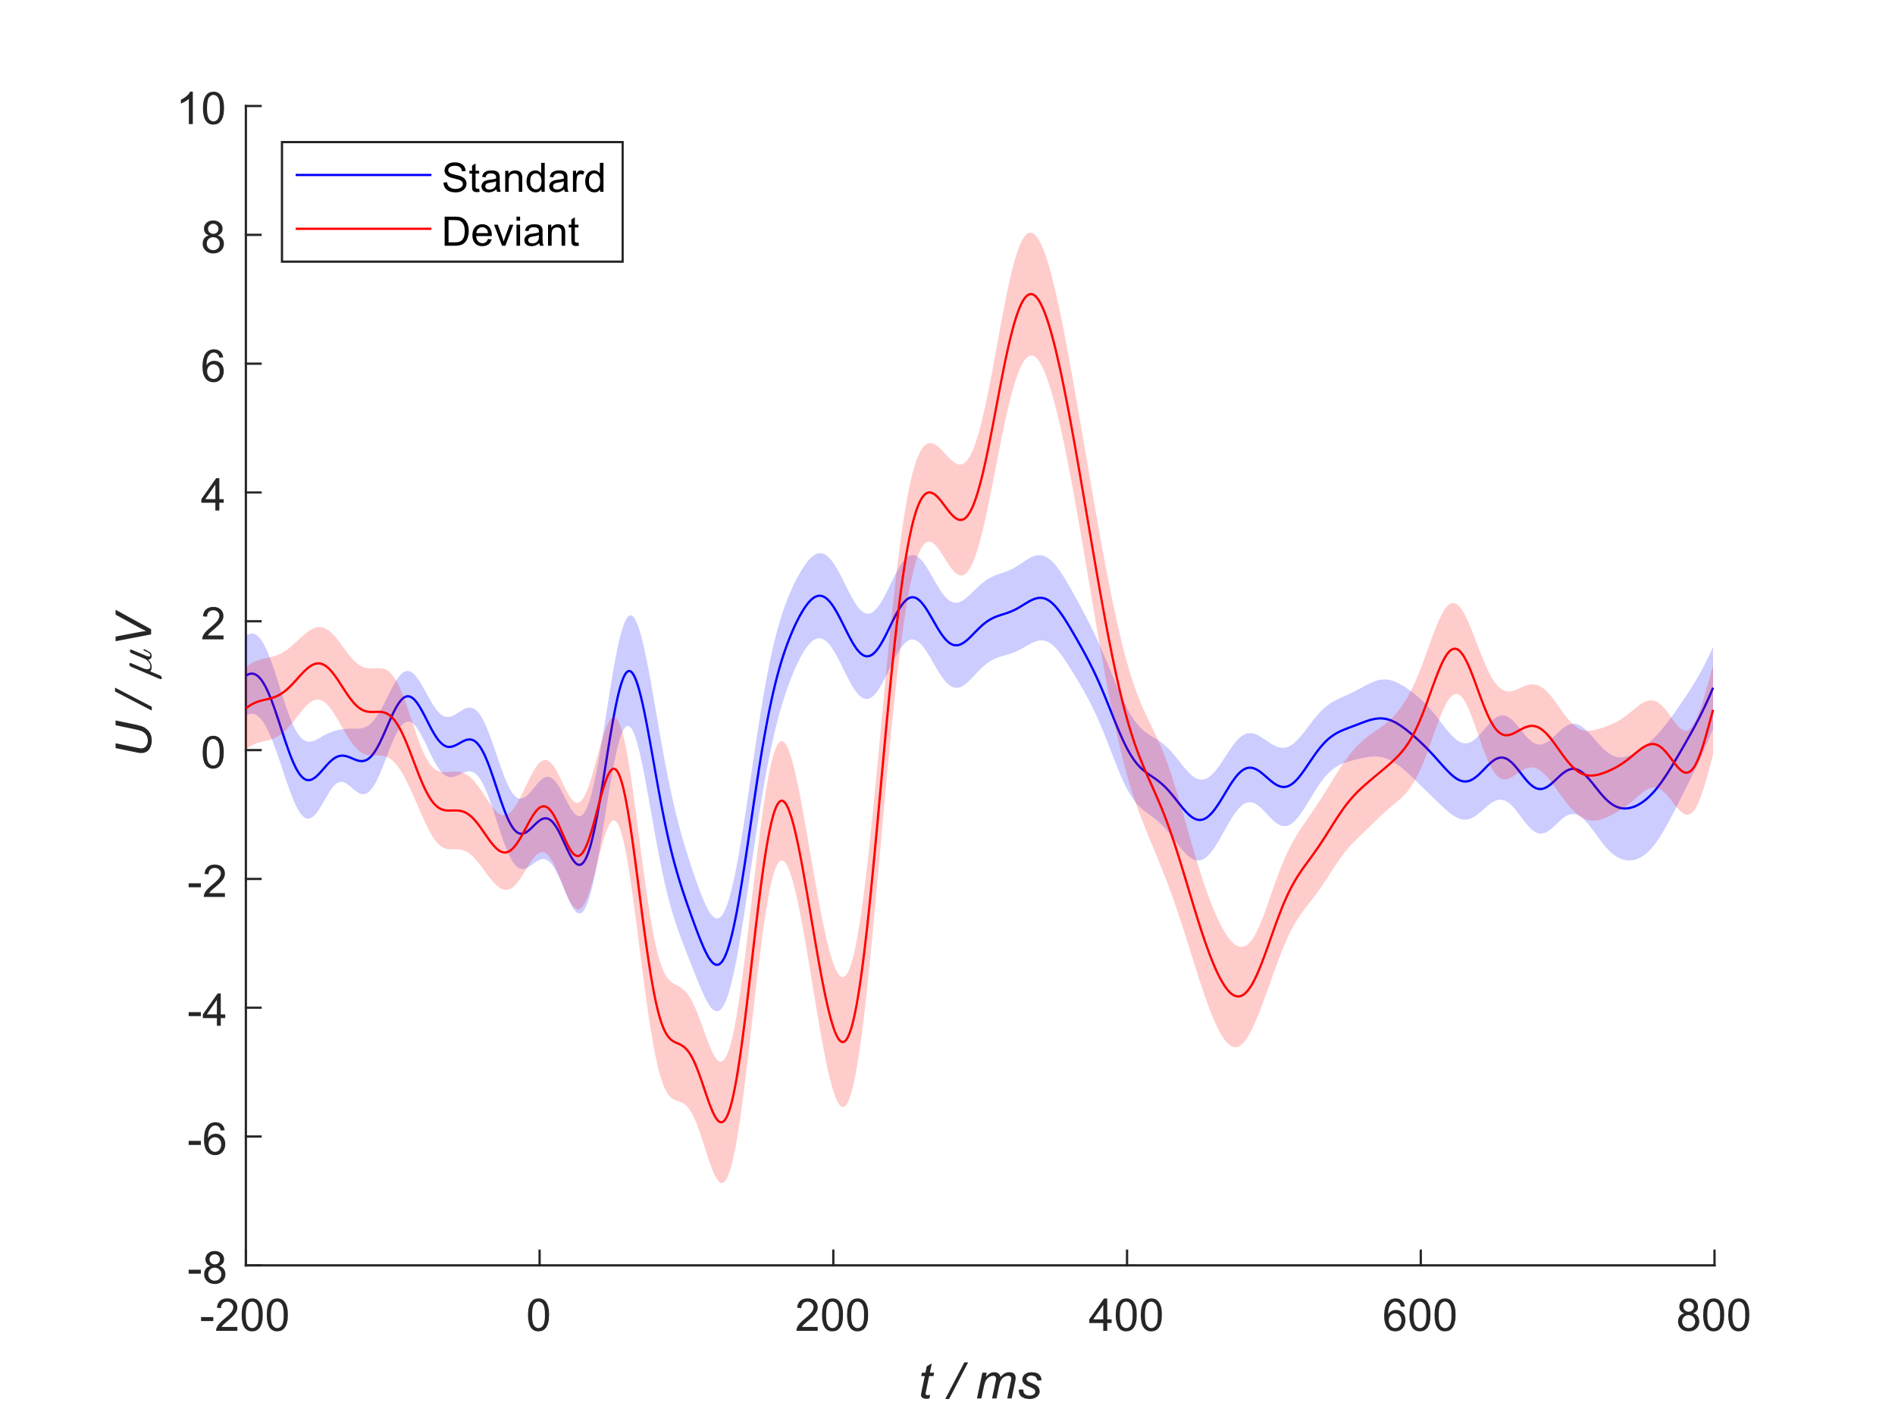

Simultaneous measurement of cEEGrid and MEG – a first attempt
Till Habersetzer¹, Martin Bleichner², Pinar Fulya Çinar³ , Andreas Spiegler³
1 Communication Acoustics, Department of Medical Physics and Acoustics, Carl von Ossietzky University Oldenburg
2 Neurophysiology of everyday life, Department of Psychology, Carl von Ossietzky University Oldenburg
3 Neuroimaging Unit, Carl von Ossietzky University Oldenburg
Introduction
Lognterm goal: Investigate sparser electrode arrays (e.g., cEEGrid) performance
Utilize MEG as a reference modality due to its extensive sensor array
Custom non-magnetic cEEGrid [1] connectors were designed and evaluated for the first time in this study
The study design was inspired by a previously recorded study with cEEGrids [2]. Within this study a rapid Oddball paradigm was conducted.
A single participant was measured with a cEEGrid attached to the right ear
The results confirm the ability to replicate the findings reported in [2] using both the cEEGrid within the MEG and the MEG
This paves the way for more complex paradigms and demonstrates the usability of the cEEGrid connector
cEEGrid + Adapter
Custom-made non-magnetic cEEGrid connector with mounting hardware and a cEEGrid
[1]
Measurement setup
306 channel Elekta Neuromag Triux
Etymotic ER 30 (300 Ohm) insert earphones
RESPONSEPixx /MRI Handheld 4-button fiber-optic response box
Custom made non-magnetic cEEGrid connector
cEEGrid attached to right ear
Paradigm
Rapid Oddball paradigm [2]
(3 runs ~ 15min)
Double tones:
Standard: Oboe-based
fundamental frequency of 100 Hz
Deviant: Clarinet-based
fundamental frequency of 300 Hz
Each run consisted of 160 trials
112 standards (70%)
48 targets (30%)
inter-trial interval randomly varied between 500 ms and 900 ms
The participant was supposed to press a button when the target tone occured
In Total:
336 standards, 144 deviants
700 ms
100 ms
500 ms
Results MEG
Event related field (ERF)
Data analysis
Low-pass filter at 25 Hz, high-pass filter at 1 Hz,
No trial rejection
All trials were kept, baseline corrected and averaged
Magnetometers are displayed
Results cEEGrid
Event related potential (ERP)
Measurement setup
Ref
Early negative component between 50 and 200 ms and a later positive component between 200 and 400 ms (P3) are visible, in both MEG and cEEGrid
[1] Debener, S., Emkes, R., De Vos, M. & Bleichner, M. Unobtrusive ambulatory EEG using a smartphone and flexible printed electrodes around the ear. Sci. Rep. 5, 16743 (2015)
[2] Hölle, D., Meekes, J. & Bleichner, M.G. Mobile ear-EEG to study auditory attention in everyday life. Behav Res 53, 2025–2036 (2021). https://doi.org/10.3758/s13428-021-01538-0

